Slide 1
MIC ROS Launch Project Tanuj Kenchannavar, Vakul Nath, Kate Sanborn

Slide 2

MIC ROS Launch Project
Project Goal
Create a tool to generate ROS launch files using a diagram.
Support importing a current file, turning it into a diagram, and exporting the diagram to a file.
Also support building a launch file from scratch.
Visually show how nodes in the launch file would be communicating.

Slide 3




MIC ROS Launch Project
ROS
Node1
Node2
Node1
Node2
msg_a
msg_a
PackageA
Node3
PackageB
Node1
Node2
msg_a
msg_a
Node4
msg_b
Node3
Node4
msg_b
PackageC
Notes:
https://commons.wikimedia.org/wiki/File:Ros_logo.svg

Slide 4

MIC ROS Launch Project
ROS Launch
Node1
Node1
rosrun PackageA Node1
roslaunch package x.launch
Node2
Node2
rosrun PackageA Node2
Node3
Node3
rosrun PackageB Node3

Slide 5
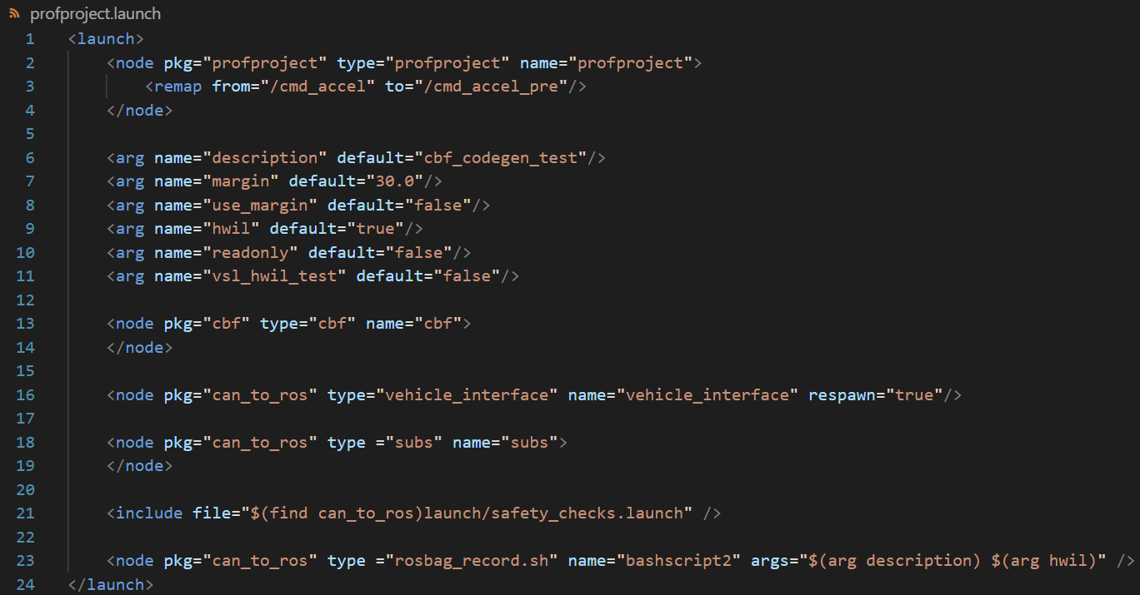
MIC ROS Launch Project
ROS Launch Files
Nodes
Remap
Arguments
Include

Slide 6
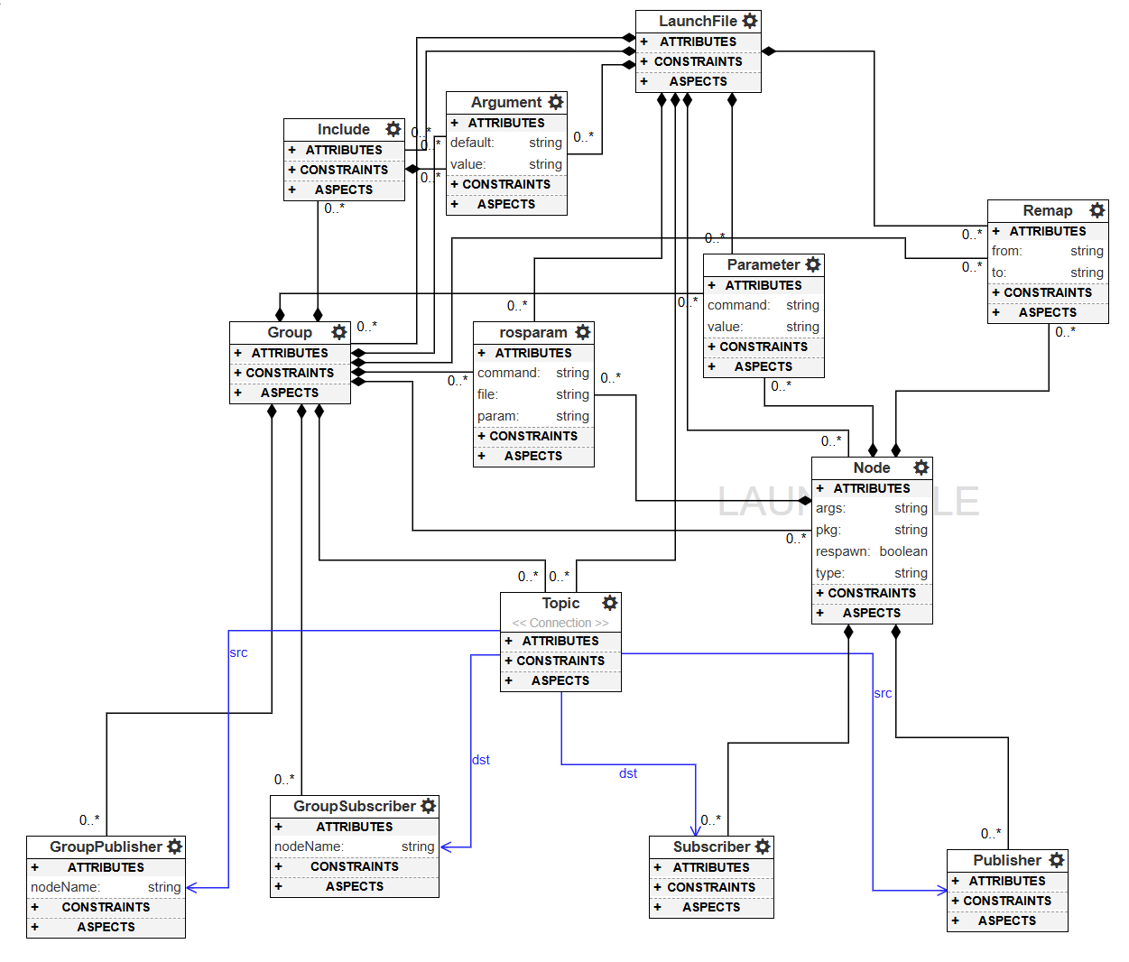
MIC ROS Launch Project
Metamodel

Slide 7
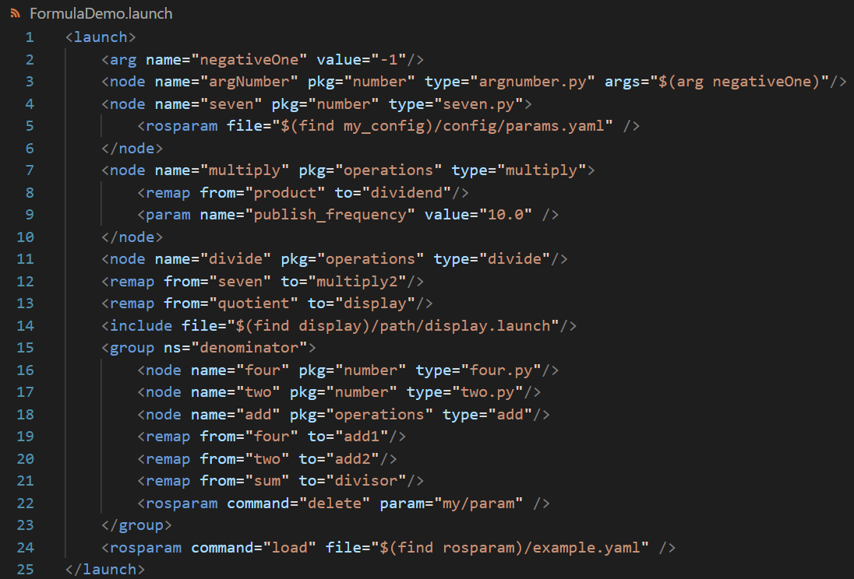
MIC ROS Launch Project
ROS Launch Example File
Toy example that solves (-1 * 7) / (4 + 2) and displays the result
Notes:
Remap number to multiply1

